Slide 1
Overview of Multiplication and Division
Course Code: COE 3205
Course Title: Computer Organization & Architecture
Dept. of Computer Science
Faculty of Science and Technology
Lecturer No: | 9 | Week No: | 13 | Semester: | Fall 22-23
Lecturer: | Md. Faruk Abdullah Al Sohan; faruk.sohan@aiub.edu

Slide 2
Lecture Outline
Overview
Multiplication
Division

Slide 3
Overview
In this chapter, we introduce Instructions for multiplying and dividing any numbers
The process of multiplication and division is different for signed and unsigned numbers. So there are different Instructions for signed and unsigned multiplication and division.
Again, these instructions have byte and word forms

Slide 4
Signed versus Unsigned Multiplication
MUL and IMUL
Syntax of MUL and IMUL
Byte Form Multiplication
Word Form Multiplication
Effect of MUU/MUL on the status flags
Simple Applications· of MUL and IMUL

Slide 5
Signed versus Unsigned Multiplication
In binary multiplication, signed· and unsigned numbers must be treated differently.
For example, suppose we want to multiply the eight-bit numbers 10000000 and 11111111. Interpreted as unsigned numbers, they represent 128 and 255 respectively.
The product is 32,640 = 0111111110000000b.
However, taken as signed numbers, they represent-128 and -1, respectively; and the product is 128 = 0000000010000000b

Slide 6
Signed versus Unsigned Multiplication
MUL and IMUL
Since signed and unsigned multiplication lead to different results. There are two multiplication Instructions:
MUL (multiply for unsigned multiplication.
IMUL for signed multiplication.

Slide 7
Signed versus Unsigned Multiplication
Syntax of MUL and IMUL
MUL source
IMUL Source

Slide 8
Signed versus Unsigned Multiplication
Byte and Word Form of MUL and IMUL
MUL and IMUL instructions multiply bytes or words.
Byte Form: If two bytes are multiplied, then product is a word (16 bits).
Word Form: If two words are multiplied, the product is a doubleword (32 bits).

Slide 9
Signed versus Unsigned Multiplication
Byte Form Multiplication
For byte multiplication, one number is contained in the source and the other is assumed to be in AL.
The 16-bit product will be in AX.
The source may be a byte register or memory byte, but cannot be a constant

Slide 10
Signed versus Unsigned Multiplication
Byte Form Multiplication
For word form multiplication, one number is contained in the source and the other is assumed to be in AX.
The most significant 16 bits of the doubleword product will be in DX,
And the least significant 16 bits will be in AX
Sometimes it is written as DX:AX.
The source may be a 16-bit register or memory word, but not a· constant.

Slide 11
Signed versus Unsigned Multiplication
Effect of MUU/MUL on the status flags
SF,ZF,AF, PF: undefined
CF/OF:
After MUL, CF/OF : = 0 if the upper half of the result is· zero , otherwise CF/OF = 1
After IMUL, CF/OF = 0 if the upper half of the result is the sign extension of the lower half (this means that the bits of the upper half are the same as the sign bit of the lower half). = otherwise CF/OF = 1.

Slide 12
Signed versus Unsigned Multiplication
Meaning of CF/OF = 1 on MUL and IMUL
For both MUL and IMUL, CF/OF = l means that the product is too big to fit' in 'the lower half of the destination (AL for byte multiplication, AX for word multiplication).

Slide 13
Signed versus Unsigned Multiplication
Example of Multiplication
Example 1: Suppose AX contains, 1 and BX contains FFFFh
Instructions | Decimal Product | Hex Product | DX | AX | CF/OF
MUL BX | 65535 | 0000FFFF | 0000 | FFFF | 0
IMUL BX | -1 | FFFFFFFF | FFFF | FFFF | 0
For MUL. DX = 0, so CF/OF= 0.
for IMUL, the signed interpretation of BX is -1, and the product is also -1. In 32 bits, this is FFFFFFFFh. CF/OF = 0 because DX is the sign extension of AX.

Slide 14
Signed versus Unsigned Multiplication
Example of Multiplication
Example 9.1: Suppose AX contains, 1 and BX contains FFFFh
Instructions | Decimal Product | Hex Product | DX | AX | CF/OF
MUL BX | 65535 | 0000FFFF | 0000 | FFFF | 0
IMUL BX | -1 | FFFFFFFF | FFFF | FFFF | 0
For MUL. DX = 0, so CF/OF= 0.
for IMUL, the signed interpretation of BX is -1, and the product is also -1. In 32 bits, this is FFFFFFFFh. CF/OF = 0 because DX is the sign extension of AX.

Slide 15
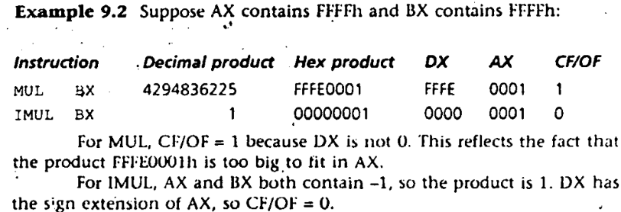
Signed versus Unsigned Multiplication
Example of Multiplication

Slide 16
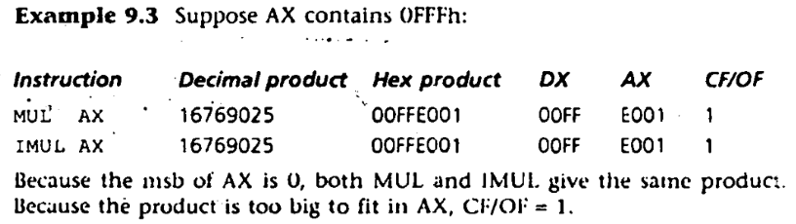
Signed versus Unsigned Multiplication
Example of Multiplication

Slide 17
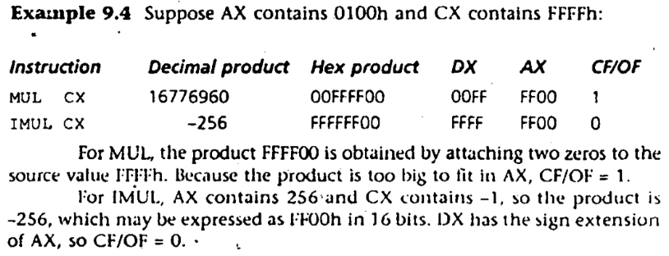
Signed versus Unsigned Multiplication
Example of Multiplication

Slide 18
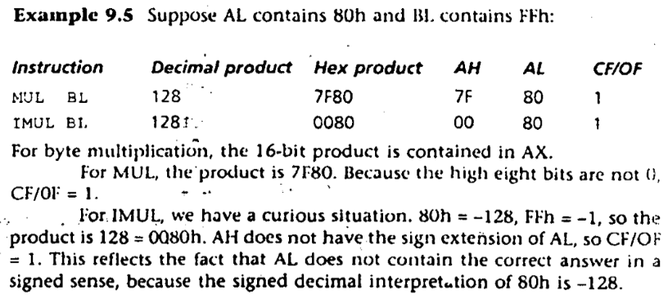
Signed versus Unsigned Multiplication
Example of Multiplication

Slide 19
Signed versus Unsigned Multiplication
Simple Applications· of MUL and IMUL

Slide 20
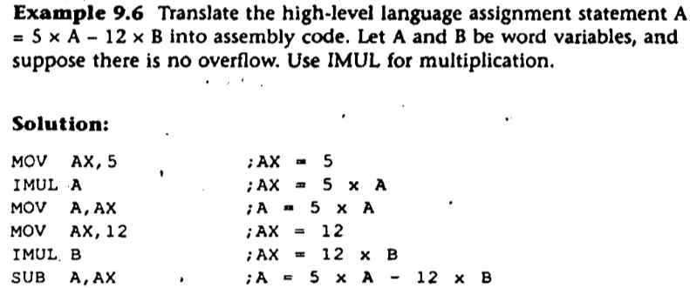
Signed versus Unsigned Multiplication
Simple Applications (1) of MUL and IMUL

Slide 21
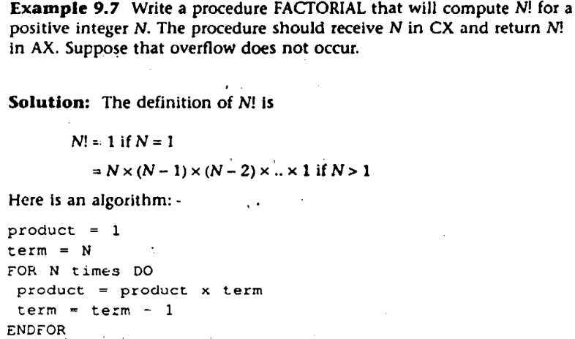
Signed versus Unsigned Multiplication
Simple Applications (2) of MUL and IMUL continues…

Slide 22
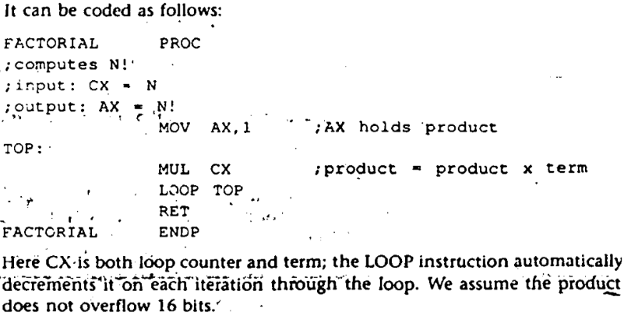
Signed versus Unsigned Multiplication
Simple Applications of MUL and IMUL

Slide 23
Signed versus Unsigned Division
Division Syntax
Division Syntax
Division Byte Form
Division Word Form
Division Overflow
Sign Extension of the Dividend

Slide 24
Signed versus Unsigned Division
Division Syntax
When division is performed, we obtain two results, the quotient and the remainder.
As with multiplication, there are separate Instructions for unsigned and signed division
DIV (divide) is used for unsigned division
IDIV-(lnteger divide) is used for signed division.
The syntax :
DIV divisor
IDIV divisor

Slide 25
Signed versus Unsigned Division
Division Byte Form
The divisor is an 8-bit register or memory byte.
The 16-bit dividend is assumed to be in AX.
After division, the 8-bit quotient is in AL and the 8-bit remainder is in AH.
The divisor may not be a constant

Slide 26
Signed versus Unsigned Division
Division Word Form
Here the divisor is a 16-bit register or memory word
The 32-bit dividend is assumed to be in DX:AX
After division, the 16-bit quotient is nn AX and the 16-bit remainder is in DX.
The divisor may not he a constant.
For signed division, the remainder has the same sign as the dividend. If both dividend and divisor are positive, DIV and IDIV give the same result.
The effect of DIV /IDIV on the flags is that all status flags are undefined

Slide 27
Signed versus Unsigned Division
Division Overflow
It is possible that the quotient will be too big to fit in the specified destination· (AL or AX).
This can happen if the divisor is much smaller than the dividend
When this happens, the program terminates and the system displays the message "Divide Overflow"

Slide 28
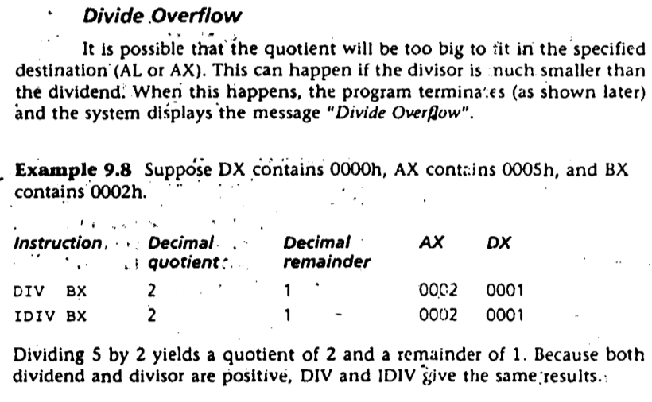
Signed versus Unsigned Division
Division Example

Slide 29
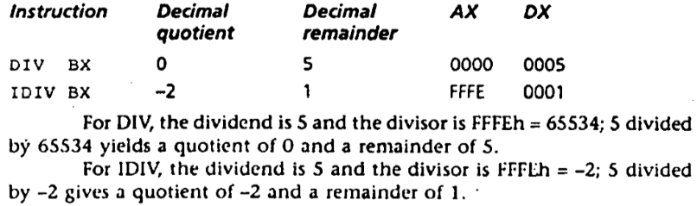
Signed versus Unsigned Division
Division Example

Slide 30
Signed versus Unsigned Division
Division Example

Slide 31
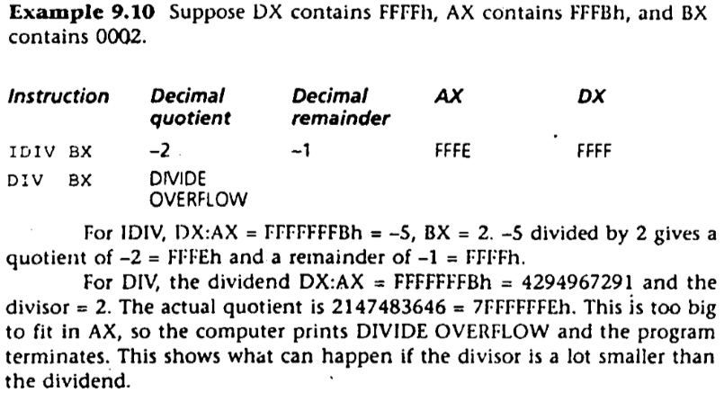
Signed versus Unsigned Division
Division Example

Slide 32
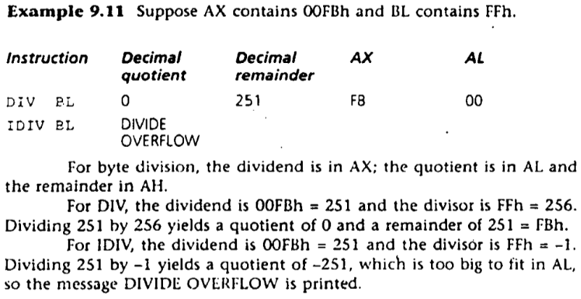
Signed versus Unsigned Division
Division Example

Slide 33
Signed versus Unsigned Division
Sign Extension of the Dividend
Word Division
In word division, the dividend Is in DX:AX even if the actual dividend will fit in AX. In this case DX should be prepared as follows:
1. For DIV, DX should be cleared.
2. For IDIV, DX should be made the sign extension of AX.
The instruction CWD (convert word to doubleword) will do the extension.

Slide 34
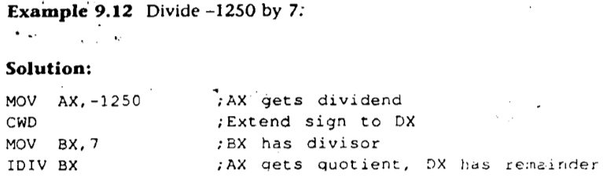
Signed versus Unsigned Division
Sign Extension of the Dividend - Example

Slide 35
Signed versus Unsigned Division
Sign Extension of the Dividend – Byte Division
Byte Division
In the byte division, dividend is in AX.
If the actual dividend is a byte; then AH should be prepared as follows:
1. For DIV, AH should be cleared.
2. For IDIV AH, should the sign extension of AL.
The instruction CBW (convert byte to word) will do the extension.

Slide 36
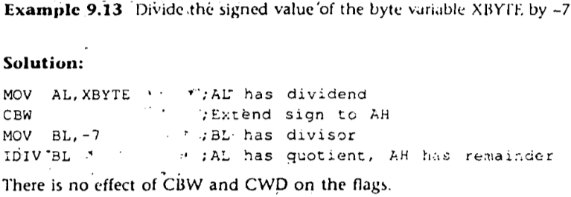
Signed versus Unsigned Division
Sign Extension of the Dividend – Byte Division example

Slide 37
Books
Assembly Language Programing and Organization of the IBM PC
Ytha Yu
Charles Marut

Slide 38
References
Multiplication and Division Instrution in Assembly
https://www.youtube.com/watch?v=LDXI8OW7kfk&t=348s
Carry and Overflow Details
https://www.youtube.com/watch?v=9cXe_T99nL4

